Slide 1


Slide 2
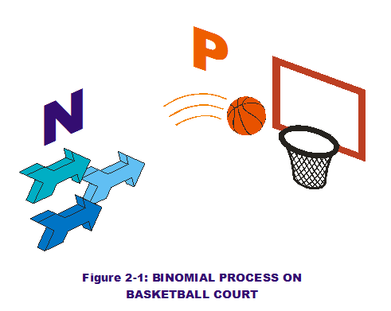
The Binomial Distribution
Bernouli Trial

Slide 3
Bernouli trial
It is that trial which has only two possible
outcomes
PASS / FAIL
TRUE/ FALSE
SUCCESS / FAILURE
IN / OUT
HOT / COLD

Slide 4
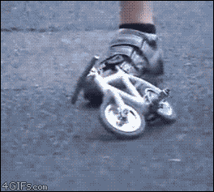
MALE / FEMALE
DEFECTIVE / NOT DEFECTIVE
RIGHT-HANDED / LEFT-HANDED
HIGH / LOW
HEAD / TAIL
& MANY MORE

Slide 5

Many types of probability problems have only two outcomes, or they can be reduced to two outcomes
i. when a coin is tossed, it can land head or tail

Slide 6

ii. A true-false questions can be answered in only two ways, true or false
iii. Fire will hit or not on the target.

Slide 7

iv. In a basketball or any such sports, a team either wins or loses.

Slide 8
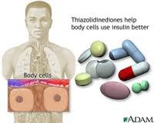
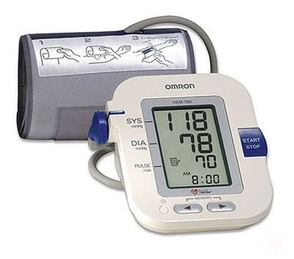
Other situations can be reduced to two outcomes. For example,
i. A medical treatment can be classified as effective or ineffective,
depending on the results.
ii. A person can be classified as having normal or abnormal blood
pressure, depending on the measure of the blood pressure gauge.

Slide 9

iii. A multiple-choice question, even though there are four or five answer choices, can be classified as correct or incorrect. Situations like these are called binomial experiments.

Slide 10
These types of experiment can be classed as binomial experiments but they must possess the following properties
The trials must be independent, i.e. the outcome of one trial does not Influence the outcome of another trial;
Each trial can have only two outcomes, which will be called
‘success’( S ) and ‘failure’ ( F );
iii. The probability of success, P (S) = p, usually just written as p, is
the same for each trial, thus the probability of failure is P( F ) =
q = 1-p ;
There must be a fixed number, n ,of identical repetitions of the experiment, called trials;

Slide 11
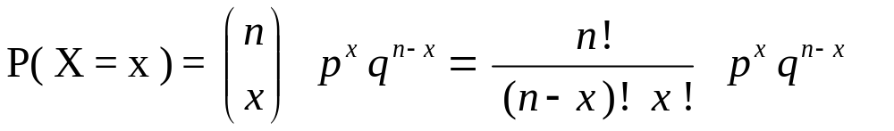
Binomial distribution Function
The experiment is interested in the number of successes,
represented by the random variable X., out of n trials
When the binomial r.v. X assumes a value x the binomial
probability mass function is given by b(x; n, p)
for x = 0 , 1 , 2 , 3 , …….. n

Slide 12
Suppose there are
n = number of trials
x = number success
n – x = number of failure
p = probability of success
q = 1 – p = probability of failure
P + q = 1

Slide 13

Example-1
The probability that a letter will be delivered anywhere in
Pakistan in 2 days or less is 0.84. If a college graduate is sending
job applications to 5 colleges, and they are all due in 2 days, find
the probability that 4 arrive within 2 days.
Solution
Success : Letter arrives within 2 days.
Failure : Letter does not arrive within 2 days.
Probability of Success : p = 0.84
Probability of Failure : 1 - p = 0.16
Number of Trials : n = 5
Number of Successes : x = 4

Slide 14
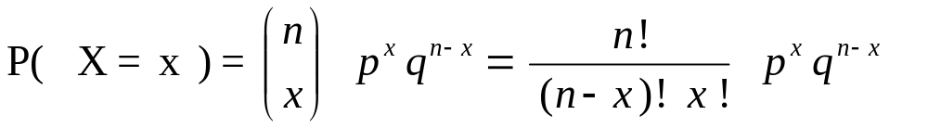
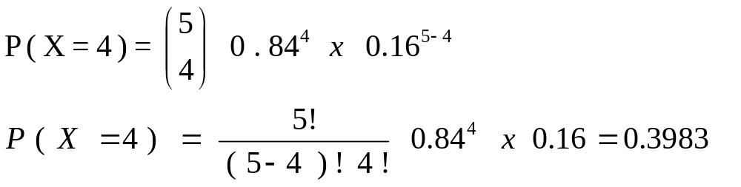
The probability that 4 of the 5 letters will arrive in time is 0.3983.

Slide 15

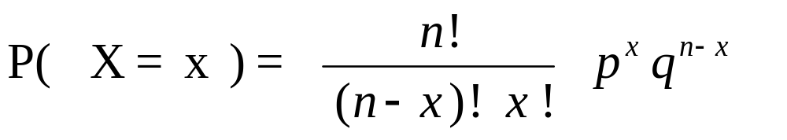
Example – 2
A doctor knows 15% of all her patients are late for their
appointments. Given five randomly selected patients, what is
the approximate probability that exactly three of them are late
for their appointments?
Solution
Success : Patients are late for their appointments
Failure : Patients are not late
Probability of Success : p = 0.15
Probability of Failure : 1 – 0.15 = 0.85
Number of Trials : n = 5
Number of Successes : x = 3

Slide 16
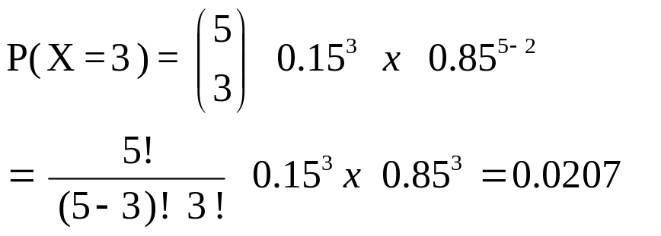
The probability that 3 of the 5 patients late is 0.0207.

Slide 17

Example - 3
An oil-drilling venture involves the drilling of six wildcat oil wells in
different parts of the country. Suppose that each drilling will produce
either a dry well or an oil gusher. Assuming that the simple events for
this experiment are equally likely, find the probability that at least one
oil gusher will be discovered.
Success : well Oil produce
Failure : well dry
Probability of Success : p = 0.5
Probability of Failure : 1 - p = 0.5
Number of Trials : n = 6
Number of Successes : x = 1, 2 , 3 , 4 , 5 and 6
P(X ≥ 1) = P(X = 1) + P(x = 2) + P(X = 3) +
P(X = 4) + (X = 5) + P(X = 6)
P(X ≥ 1) = 0.0937+ 0.2343 + 0.3125 + 0.2343 + 0.0937+ 0.0156
P(X ≥ 1) = 0.9814

Slide 18
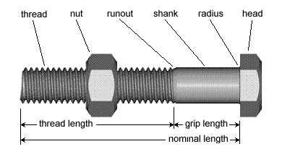
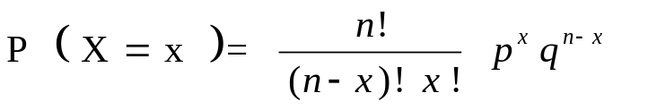
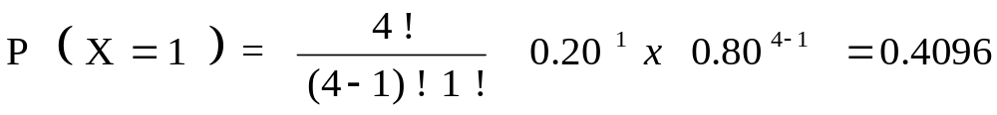
Example - 4
20 % of the bolts produced by a machine are defective, find the
probability that out of 4 bolts chosen at random 1 bolt will be
Defective.
Success : bolt defective
Failure : non defective
Probability of Success : p = 0.20
Probability of Failure : 1 - p = 0.80
Number of Trials : n = 4
Number of Successes : x = 1
The probability that 1 of the 4 bolts is 0.4096.

Slide 19
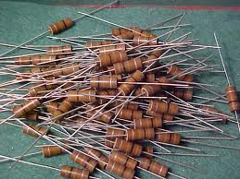
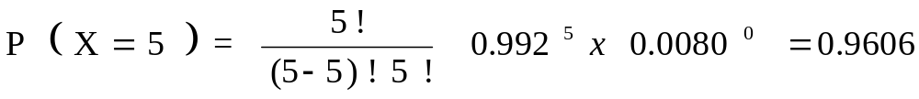
Example – 5
A circuit requiring a 500-ohm resistance is designed with five 100-ohm
resistors connected in series. The proper resistance is achieved only if all five
resistors work successfully. There is a 0.992 probability that any individual
resistor will work successfully. What is the probability that all five resistors
will work successfully to provide the necessary resistance?
Success : resistors work successfully
Failure : resistors fail
Probability of Success : p = 0.992
Probability of Failure : 1 - p = 0.008
Number of Trials : n = 5
Number of Successes : x = 5

Slide 20
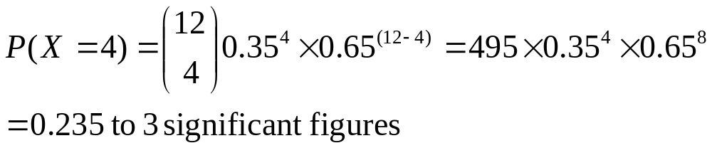
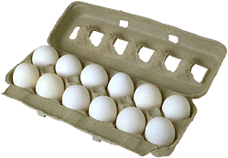
Example - 6
Eggs are packed in boxes of 12. The probability that each egg is broken is 0.35.Find the probability in a random box of eggs:there are 4 broken eggs

Slide 21
Probability & Statistics for Engineers &; Scientists
(E I G H T H E D I T I ON) by Ronald E. Walpole.
Questions: 5.2 to 5.13

